Slide 1
Requirements aka Stories
A module in the
Agile Business Analysis
workshop
This work is licensed under the
Creative Commons Attribution-ShareAlike 4.0 International License.
To view a copy of this license, visit http://creativecommons.org/licenses/by-sa/4.0/.

Slide 2
Topics
Introduction to stories
Acceptance criteria
Cross functional requirements
Representing stories

Slide 3
BA Artifacts
Inception
Iterations
Vision
Prioritized business objectives
Roles & personas
Scenarios
Narratives
Story maps
Right sized stories
Initial story list (Backlog)
Release plan with estimate
Functional test matrix
Notes:
A number of artifacts are created during inception. Typically only 1 during Iterations.
To help get to an initial estimate, release plan
The analyst is key to understanding what needs to be built functionally
There are a number of techniques used to obtain that understanding.
Are all these documents kept up to date? Not unless you discover a large piece missing. A whole scenario missing from the process flow. A role missing or completely off the mark definition.
The level of detail of the inception artifacts are at a much higher level than traditional methodologies.

Slide 4
All About Stories
Notes:
We’ve got a lot of models that we’ve created during our User Research.
Roles and their goals
Process maps
Scenarios
Personae
We use those artifacts to pull stories from.
How do we write quality stories.
Low: 1min
High: 3min

Slide 5
Story
Unit of work
Completed within an iteration
Used to track progress
Placeholder for conversations
User’s perspective
Can be estimated
Can be tested
Index card
Initial Story List
Product backlog
One story
Notes:
Term coined by Kent Beck in Extreme Programming Explained, 1st edition. 1999.
A unit of work in an agile project. A bit bigger than a feature, smaller than a use case.
Must be able to complete within an iteration.
Used to track progress. How well are we doing? How much more to do? Etc.
Written from the user’s perspective. Understandable by the customer.
Stories are scheduled into iterations. Stories require conversations between the BA and the customer in order for the BA to write the narrative. The narrative encourages conversations between the BA and Dev. Ron Jeffries 3 Cs. Card, Conversation, Confirmation
Can be estimated.
Can be tested.
Initially a story is written on an index card. During inception, these cards are torn up, added to, modified, etc. Stories are then put into whatever tracking tool is used on the project.
A MSL is living collection of stories. Initially created in the inception phase and modified potential after each iteration and definitely for each Release.
Low: 3min
High: 6min

Slide 6
Iteration / Release
Iteration
A collection of stories
Selected by the customer
Iteration Planning Meeting(IPM)
Team commits to delivering
1 – 2 weeks
Release
A collection of iterations
Release planning
Target 3 months
5 - 10 Stories
30 - 50 Stories
Notes:
An iteration is a collection of stories the team commits to delivering in a fixed period of time typically 1-2 weeks.
The stories for each iteration are selected/prioritized by the customer.
At the IPM, the capacity and velocity are used to determine how many stories can be completed.
The team then commits to delivering selected stories.
A release is a collection of iterations that allow the business to use the application in production.
Release planning determines what stories go into what iterations and how many iterations will be in each release.
Planning out farther than 3 months increases the estimate risk. Chances are the farther out you plan, the more changes there will be
Low: 2min
High: 6min

Slide 7

Quick Quiz
A story is…..
Written from the user’s perspective
Captured through lengthy analysis
Written on a card
Written as a technical solution
All written at the beginning of the project
Captured through rich conversations
Written as a lengthy requirements document
Notes:
Ask for a show of hands for yes or no for each question.
[CLICK] to reveal the answer.
Low: 2min
High: 3min

Slide 8
Parts of a Story
Unique #:
Title:
Priority:
Description:
As a <Role>
I want to <Goal>
So that <Value>
Assumptions:
Estimate:
Notes:
We capture information initially on index cards.
At the end of Inception, we may transfer our stories to a Story Tracking system.
We may also keep our index cards for our Iteration story walls
You’ll see there is a fair amount of information to capture for a story.
Both front … [CLICK]

Slide 9
Parts of a Story
Unique #:
Title:
Priority:
I will know this is complete when…….
Complexity:
Completeness:
Volatility:
Notes:
And back of the card. If you’re using index cards.
We’ll talk about each of these now.
You may hear the acronym RAIDs
Risk
Assumptions
Issues
Dependencies
Low: 1min
High: 2min

Slide 10
Description
Role: As a …
Unique #:
Title:
Goal: I want/need …
Priority:
Description:
As a <Role>
I want to <Goal>
So that <Value>
Value: So that …
Estimate:
From User Stories Applied: For Agile Software Development by Mike Cohn
Notes:
From Mike Cohn’s book “User Stories Applied”.
Role
Identified during inception
Identifier for a common set of tasks or permissions
[CLICK]
Goal
What the user wants to do, not what the system is supposed to do.
The feature
[CLICK]
Value
Why are we building this functionality?
Should tie back to a business objective
Low: 3min
High: 5min
--------------------------------------------------------------------------------------------------------------------
The story template we use comes from Mike Cohn’s book “User Stories Applied”. It has three parts:
The Role: this is an identifier for a common set of tasks or permissions.
The Goal: this is what is to be accomplished. This is stated in terms of what the person or role wants to accomplish, not what the system is supposed to do.
The Value: this is one of the most important parts. Without understanding what this story means to the person in the role or the organization – the business – we are left asking the question “why are we doing this?” The value statement may be the hardest part of user stories. Expressing the role and the goal are generally pretty clear, although we’ve seen some challenges there too. The value, though, is hard. People are inclined to say things like “because that’s my job!” or “so that we can do our business.”
We’ll come back to this template repeatedly as we go, because it’s such a key part of what we do and how we do it.

Slide 11
A Helpful Acronym
Independent
Negotiable
Valuable
INVEST
Estimatable
Small
Testable
Bill Wake, author of Extreme Programming Explored uses the INVEST acronym to guide story writers.
Notes:
Bill Wake, author of Extreme Programming Explored uses the INVEST acronym to guide story writers.
We use the INVEST acronym as our guideline for writing good stories.
1min

Slide 12
Independent
Can be developed on its own
Makes planning and estimation easier
Not always possible
Independent within an iteration
Notes:
Can be delivered on its own, with no dependencies on any other story(s).
Either combine or split stories differently to reduce or eliminate the dependencies.
Notice I used reduce. Independence is not always possible.
For example: “the first report will take 3 days, 1 day for each similar after that”. Or “it will be three days to develop rule 1 for object type a, and then 1 day for all other object types”.
Write all stories as if they were the first story so devs will estimate all as if they were the first.
Story Anti-Pattern Get invoice information from the Invoice database
Story Pattern As an Accounts agent, I want to create an invoice so that my company can request payment from the Customer
The agent really wants a printed invoice so they can send it to the customer.
Combine it with the card that says 'Print invoice‘ .
Vertical slice of subset of information.
Low: 2min
High: 4min

Slide 13
Negotiable
Not a contract
Captures the essence
Notes:
A story is not a contract. Details will be co-created later by the BA, Business and Developers through Conversations. Even QA.
The narrative or other artifact will capture details like data elements, screen design, tests, etc, but we do not need these details to prioritize, schedule or even estimate stories.
A good story is flexible in implementation.
Story Anti-Pattern
Display summary results for a patient including date, result status and results indicator (normal or abnormal).
Story Pattern
As a physician, I want to see summary results for a patient so I can quickly see if the results are normal. Notes: Actual info to display needs more analysis. Will include date, result status and result indicator (normal or abnormal). There are no other integration points.
The anti-pattern actually reads pretty well, doesn't it? You might pick up this story and think it's close to be ready for development. But that wasn't the case on the real project.
The story actually required the display of a lot more information than what was described on the anti-pattern, and that data needed quite a bit of analysis. The story actually went to three iterations because the team was forced to replay the story twice in order to get all of the result information they needed to display.
Stay away from adding detail to the story. Use the notes to write down what you've learned and make it clear that isn't the whole enchilada.
Low: 2min
High: 4min

Slide 14
Valuable
“So that ….”
Valuable to who
Value rating
Business can write stories
Notes:
This is focused on the ‘So that …’ part of the story.
Valuable to the business. Technical stories? Ultimately valuable to the business, but not obvious to the customer.
Network, persistence, logic, presentation layers.
Each card will have a business value rating. Sometimes this is in the form of a priority. A,B,C/1,2,3.
If you tie each story to a business objective, those business objectives may have been quantified and some have more value than others. Used to prioritize.
Include the business in writing stories.
Story Anti-Pattern
Turn font red if payment is overdue
Pattern
As an Account Manager, I want to see a visual indicator on the customer's screen of any invoices that are overdue so that I can send an overdue notice
Explanation There are many things wrong with the anti-pattern. The most obvious is that we don't know who needs the font red or why. It may not even be that they want red font - it's just what the system currently does.
Do the following to help:
Isolate the functionality needed (e.g. see a visual indicator for overdue invoices)
Identify the role(s) that are interested in the action (often roles have different needs)
Identify the reason (the business value) for the request This enables you to: a) get consensus on what indicator everyone wants to see b) allows you to understand why the indicator is needed.
C) helps you to understand logic behind the indicator
Low: 2min
High: 4min

Slide 15
Estimatable
Unit of work
Understandable
Precision not required
Consistency
Notes:
The unit of work being measured and tracked
Must be understandable in order to estimate
Precision not required
Consistency in the granularity of stories
The story is the key to tracking progress of a project.
Each story has to be estimated in order to know where u r and how much is left.
If a story is not understandable, then it can’t be estimated. Therefore, u could say it needs to be understandable, but that doesn’t fit in the acronym.
Estimates are just that. Of course we want to be as accurate as possible, but that comes with experience. Precision and therefore details are not necessary.
Stories should be consistently sized. It’s easier to plan and fit stories into iterations.
Story Anti-Pattern:
As a cashier I want to take payments via credit card so I can make a sale
Story Pattern:
Story 1a: As a cashier, I want to take payments via American Express so I can make a sale Story 1b: As a cashier, I want to take payments via Visa or Mastercard so I can make a sale
Explanation
The anti-pattern is just too big and uncertain to estimate. Any number you throw out there isn’t going to tell you anything. Spike the story a bit (analysis spike) and take a look at the interfaces from a data perspective.
Notice this story has 3 credit card types but only 2 stories. Turned out the Visa and Mastercard interface were so similar there was little additional work involved in getting Mastercard working.
This is a point toward consistent granularity. The team could have created a 3rd story ‘Take payment via Mastercard’ but at the master story level it would have thrown the granularity off. It made more sense to roll them up and break them down at the iteration level if needed later.
Low: 2min
High: 4min

Slide 16
Small
Fit in an Iteration
Easier to understand/estimate
More accurate estimates
Small descriptions = small stories
Notes:
Remember, they need to fit into an iteration. But not take up the whole iteration. Risky. Occasionally you will have Epics, but that is a conscious decision and planned for.
Large stories are harder to estimate and less accurate since there is a lot more in them and you could miss key rules, ideas, concepts, requirements.
If you keep the descriptions short and concise, then story is likely to be smaller estimate wise
Story Anti-Pattern - Multiple Stories in One
Process payment from customer
Story Pattern - Multiple Stories
As an Accounts agent, I want to enter basic payment information and have it displayed so I can verify it has been recorded correctly
As an Accounts agent, I want the customer's payment to show up when I search the payment history so I know whether the payment will display on their invoice
As an Accounts agent, I want the customer's payment to display on their invoice so they know we have received the payment
Explanation Large stories are often stories that are actually many stories in one. Break them up into smaller vertical slices of what's actually needed. Remember to get the right level of granularity - don't break them up too small.
Low: 2min
High: 4min

Slide 17
Testable
The Confirmation part of the 3Cs
Testable by everyone
Defined before the story is developed
Notes:
In order for everyone to know when the card is done, the story must be testable.
Developer knows when they are done, when their unit tests past.
BA knows when the card is ready for QA, when the acceptance tests pass.
QA knows when the card is done for tracking when their tests pass.
Acceptance criteria is defined during Inception and elaborated in the Narrative.
Anti-Pattern
Get external link types
Pattern
As a user, I want to see the links to external websites that I have saved for myself display on the home page when I log on, so I can easily do research using these links. Explanation How do you test 'get external link types'? This story put the developers and testers in quite a bind. Rewriting it with a business focus made it a piece of cake
Low: 2min
High: 4min

Slide 18
Other Guidelines
Write from the stakeholder perspective
Notes:
Always write it from the business perspective
As a Network Loading Manager, I want to view the necessary car and shop information, so that I can assign the car to the appropriate shop
Low: 3min
High: 6min

Slide 19
Other Guidelines
From the UI to the data store
Notes:
It should start and end at the UI (we call this vertically slicing a story)
It is never ‘Record transaction’ or ‘Add field to DB’
Low: 3min
High: 6min

Slide 20
Other Guidelines
Keep it implementation free
Notes:
Keep it implementation free
It is not ‘I want to call this method to…’
Low: 3min
High: 6min

Slide 21
Other Guidelines
Consistent granularity
Notes:
It has consistent granularity at each level of story (master, release and iteration level)
Low: 3min
High: 6min

Slide 22
Different levels of requirements
Themes
Epics
Stories
Tasks
Security
Customer
Debtor
Letters
Login
Customer
Maintenance
Debtor
Maintenance
Generate letters
Forgot Password
Deactivate
Customer
Enter New Debtor
Paid in full
letters
Connect to
LDAP
Find status of
debtors
Missing required
Fields error
Collect all PIF
letters
Notes:
To Do: Clean up, make better, show different levels
We need to come to terms with the right size for Stories.
Stories, whether in MSL for Release Planning or for Iterations, should be small enough to fit into an Iteration. Right?

Slide 23
When do we write stories
Business Objectives
and Context
High Level Scope
Themes
Roles & Goals
“As is” process
Personas
Themes
Epics
Pain Points
User Journeys or Scenarios
Prototyping
Stories
Story Writing Session
Non Functional Requirements
Stories
Notes:
We can start writing stories from the beginning of the Inception. We can start capturing Themes and then drill down to Epics and then ultimately right sized stories.

Slide 24
Story Writing
Split into equal groups
Write stories for your Functional Area / Role
Use the standard format
As a…
I want to…
So that…
Notes:
Low: 10min
High: 20min

Slide 25
INVEST Exercise
Split into equal groups
Read the hints for each principle
Read the story example
Note as much as you can tell what is wrong with the example
Rewrite the Story to be correct
Present your solution to the group
Notes:
Low: 10min
High: 20min

Slide 26
Story Example 1
As an Administrative Assistant
I want to get payment information for invoices from the database
So that I know what amount is currently due when I create a letter.
I will know this is complete when I run the letter process and the correct amount due is reflected on the letter.
Notes:
Is this about getting payment information into the system? Or about generating letters.
The acceptance criteria is bad as it requires the letter to be complete. Not independent.
Get information from the db is really discussing implementation. Not negotiable.
Are we getting the information automatically or manually?
If automated, then real time or batch request?
Is this too big for one iteration?

Slide 27
Story Example 2
As a Customer
I want to view invoice #, debtor, amount due, date due, payments made to date, status of invoices
So that I can track progress of Debt Chasers collection activities.
I will know this is complete when I search for an invoice and I see the above information.
Notes:
The list of fields shows a false sense of completeness of the information to be viewed. Not Negotiable.
We do see this is from the Customer point of view, but are they viewing one invoice or multiple for a debtor? Estimatable
We also don’t know how the Customer wants to search for the invoices. This could be very big.

Slide 28
Story example 3
As a Salesperson
I want to turn the font red if customer has not submitted a new invoice for processing in 3 months or more
So that I can see if the customer is an old customer.
I will know this is complete when customer information is red.
Notes:
Turn font red is not negotiable. We want some type of an alert.
The value statement is weak. We really want to see if a customer hasn’t been doing biz with us, so we can call on them and generate more biz.
Where should the customer information be red? Should this really be a report? Testable.

Slide 29
Story example #4
As an Administrator,
I want to process today’s letters
So that they are mailed on time.
I will know this is complete when I run the batch process and the letters are generated
Notes:
How are the letters generated? Email, hardcopy?

Slide 30
Story example #5
As a salesperson,
I want to see the status of all my customers
So that I can check on the ones I need to check on.
I will know this is complete when I can see the status of all my customers on one screen.
Notes:
What status are we looking for? This is potentially a huge story.
Do we want to see how many debtors we are working for a customer? How many invoices we are processing for one customer?
Detail or summary?

Slide 31
Story example #6
As the Managing Director,
I want to monitor employee performance
So that I can manage my business.
I will know this complete when I can see my employees’ performance
Notes:
Admins? Sales?
What information are we looking for? Testable, Estimatable, we don’t know size,

Slide 32

Debrief
What went well?
What key learnings did you take from that exercise?
What still puzzles you?
Notes:
Debrief:
What went well?
What key learning's did you take from that exercise?
What still puzzles you?
Low: 5min
High: 15min

Slide 33

Writing acceptance criteria
Collaborative
Define “complete”
Use Wisdom of Crowds
Multiple criteria
All or nothing
Use a template?
Notes:
Derived with the customer and someone technical to provide feasibility
Ask the customer: What will you observe when the story is successfully complete?
Use Wisdom of Crowds
Most stories will generate multiple criteria
All must be met before the story can be completed
Consider using a template
Use the Wisdom of Crowds approach to defining.
Diverse set of independent individuals
Maximize the effectiveness of decision making process
BA, Biz, Devs, QA all participate in defining the acceptance criteria
Low: 2min
High: 5min
----------------------------------------------------------------------------------------------------------------------------------------
If you have attended the Leadership or Project Management training, you will recall the concept of Collective Wisdom, or Wisdom of the Crowds. In short, collective wisdom demands the use of a large, diverse set of independent individuals to maximize the effectiveness of decision making processes. This same approach should be considered for acceptance criteria in order to obtain the best coverage of criteria across the requirement. Developers, analysts, architects and testers should all be able to provide useful input to generating acceptance criteria.
If you don’t have any background information on these topics, try http://en.wikipedia.org/wiki/Collective_wisdom or http://en.wikipedia.org/wiki/The_Wisdom_of_Crowds .

Slide 34
Inception Level Acceptance Criteria
As a CSR,
I want to sign on to the system,
so that I can see my work queue.
I will know this is complete when I have entered my login and password correctly and my work queue with the following data is displayed. See screen for details.
I will know this is complete when…….
Assumptions:
Notes:
Inception level acceptance criteria gets us enough information to make an estimate on the story card.
We’ll talk later about Iteration level acceptance criteria.
Low: 1min
High: 3min

Slide 35
Inception Level Acceptance Criteria
“I will know this is complete when……”
As a CSR, I want to sign on to the system, so that I can see my work queue.
I will know this is complete when I have entered my login and password correctly and my work queue with the following data is displayed. See screen for details.
Alternative path may include if there are no items in the queue.
Alternative path may include if I am not an authenticated user.
Notes:
There are typically more than one path
Try to think of them at this point. Don’t worry about the results for each path.
The more you identify up front, the better your estimate will be.
Low: 1min
High: 3min

Slide 36
RAIDs
I will know this is complete when…….
I have entered my login and password correctly and my work queue with the following data is displayed. See screen for details
Assumptions:
User is an authenticated user.
Notes:
Include any assumptions you are making when writing this acceptance criteria.
Assumptions help the developers estimate
This will also help later when something changes and the assumption(s) are no longer are valid.
You may hear the term RAIDs when talking about stories.
Risks – we will talk about this soon. Probable Issue.
Assumptions -
Issues – Should also be captured for the story. Known, existing situtation.
Dependencies – unavoidable dependencies.
Low: 2min
High: 5min

Slide 37
Acceptance Criteria
Write acceptance criteria for your stories using the following format:
Given
When
Then
Notes:
Low: 10min
High: 20min

Slide 38
Cross-Functional Requirements
Notes:
Sometimes called the ‘-abilities’
1min

Slide 39
#212:
Title: Single sign on
As a: system administrator
I want: all systems to be accessible by users with a sign on
So that: users will save time when accessing needed information.
Complexity: 2
Completeness: 1
Volatility: 1
Estimate: 5
Notes:
Example of a non-functional requirement
1min

Slide 40
Cross Functional Requirements
Archiving
Auditability
Authentication
Authorization
Availability
Compatibility
Configurability
Continuity
Data Integrity
Data Protection
DDA / Accessibility
Documentation
Extensibility
Help
Installability
Integratability
Interoperability
Leverageability/reuse
Localization
Maintainability
Multiple environment support
Operational
Performance

Slide 41
Cross Functional Requirements cont.
Personalization
Portability
Privacy
Recoverability
Reliability / Safety
Reporting
Scalability
Security
Supportability
Upgradeability
Usability/achievability

Slide 42
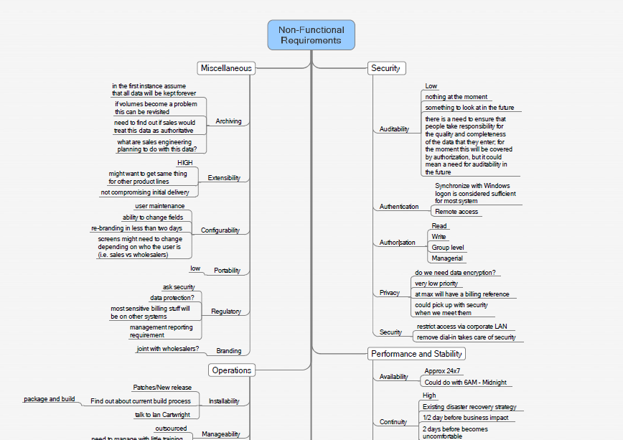
Representing CFRs
Notes:
An alternative way to represent non functional requirements would be informally in a tree.
Until a specific requirement is defined, track progress, decisions, etc here.
Low: 1min
High: 5min

Slide 43
CFR Story Examples
Accessibility
As the system administrator, I want all systems to be accessible by users with a single sign on, so that users don’t have to maintain multiple logins and passwords.
Notes:
Low: 1min
High: 2min

Slide 44
CFR Story Examples
Auditability
As a system user, I want to see a history of changes to key fields along with who changed it and when so that I can understand the process and status of the object better.
Notes:
Low: 1min
High: 2min

Slide 45
CFR Story Examples
Extensibility
As the COO, I want the system to be extended to French and Spanish language and currency within 2 years of the initial deployment, so that those operations can benefit from the functionality of this new system.
Notes:
Low: 1min
High: 2min

Slide 46
Any ideas for CFR for Debt Chasers?
Notes:
Talk through some potential CFR for debt chasers.
Performance
Accessibility – down time
Concurrent users – scalability

Slide 47
BA Artifacts
Inception
Iterations
Vision
Prioritized business objectives
Roles & personas
Scenarios
Narratives
Story maps
Right sized stories
Initial story list (Backlog)
Release plan with estimate
Functional test matrix
Notes:
A number of artifacts are created during inception. Typically only 1 during Iterations.
To help get to an initial estimate, release plan
The analyst is key to understanding what needs to be built functionally
There are a number of techniques used to obtain that understanding.
Are all these documents kept up to date? Not unless you discover a large piece missing. A whole scenario missing from the process flow. A role missing or completely off the mark definition.
The level of detail of the inception artifacts are at a much higher level than traditional methodologies.

Slide 48
Checking for Missing Stories
Notes:
1min

Slide 49
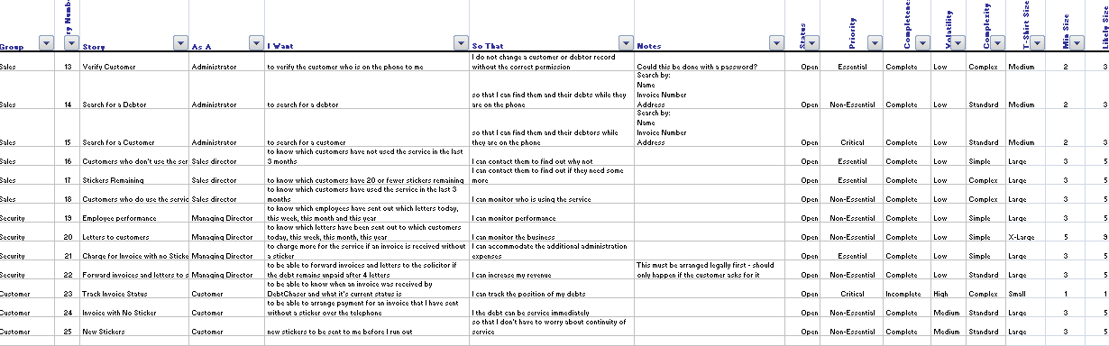
Initial Story List
Notes:
Looking at a list of stories is not helpful to identifying missing stories.
If we map them out, we can see missing pieces easily.
If you recall from our index card picture, there is a lot to track for a story.
How un-agile! But no, not all organizations want to be ‘that’ agile right away.
That takes courage.
You can use excel, Mingle, v1, to manage your list.
Sometimes a combination. Mingle or v1 do not manage capacity.
Low: 1min
High: 2min

Slide 50
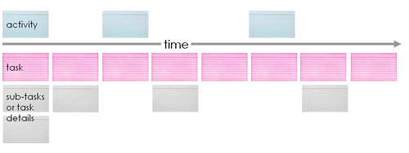
Story Mapping
a.k.a. Walking Skeleton, Hudson River Company Start, or Tracer Bullet
Diagram from Jeff Patton’s blog
http://www.agileproductdesign.com/blog/the_new_backlog.html
Notes:
A Master Story List is helpful for a number of things, but it does not easily represent what is being built.
Story Mapping is an approach that intersects with Vertical Slicing, and adds a focus on creating value to address a specific business need - according to Jeff Patton, “a minimum viable product - an MVP.” Jeff’s example is building a car – you can’t do anything with it if it has an engine without a transmission or brakes or suspension.
In Story Mapping, we look for the set of stories (features, user tasks, user stories) that create some specific functionality such that the system can be used. These are “horizontal” in that we don’t care about the system’s layers, but rather care about having all the pieces we need to be able to do something. In fact, we pretty much ignore the layers we considered in Vertical Slices, at least from the standpoint of planning.
Low: 3min
High: 6min

Slide 51
Story Mapping
Using the stories from the master story list
Lay the stories out left to right in sequence or activity flow
Lay related tasks and/or subtasks below the activity
Group like stories. Create high level tasks for them
Eliminate duplicates
Notes:
Use the stories from the MSL
Arrange them left to right in sequence of task flow.
Group like stories, create high level cards for them.
Eliminate duplicates.
What’s common? What’s different?
Low: 20min
High: 30min

Slide 52
Debrief
What went well?
What key learnings did you take from that exercise?
What still puzzles you?
Notes:
Debrief:
What went well?
What key learning's did you take from that exercise?
What still puzzles you?
Low: 5min
High: 15min

Slide 53
Review
Introduction to stories
Acceptance criteria
Cross functional requirements
Representing stories

Slide 54
BA Artifacts
Inception
Iterations
Vision
Prioritized business objectives
Roles & personas
Scenarios
Narratives
Story maps
Right sized stories
Initial story list (Backlog)
Release plan with estimate
Functional test matrix
Notes:
A number of artifacts are created during inception. Typically only 1 during Iterations.
To help get to an initial estimate, release plan
The analyst is key to understanding what needs to be built functionally
There are a number of techniques used to obtain that understanding.
Are all these documents kept up to date? Not unless you discover a large piece missing. A whole scenario missing from the process flow. A role missing or completely off the mark definition.
The level of detail of the inception artifacts are at a much higher level than traditional methodologies.

Slide 55
Questions?

